Slide 1
Try CSBDeep for celegans microscopy images
Zheng Lu

Slide 2
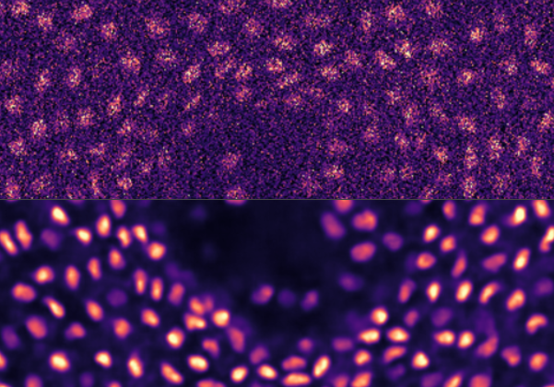
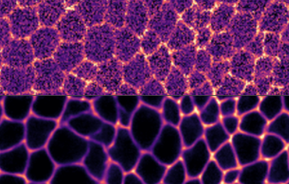
CSBDeep
CSBDeep is a neural network for microscopy image denoising.
It has been trained on several datasets. Two datasets are similar to our celegans images:
Planaria
Flywing

Slide 3
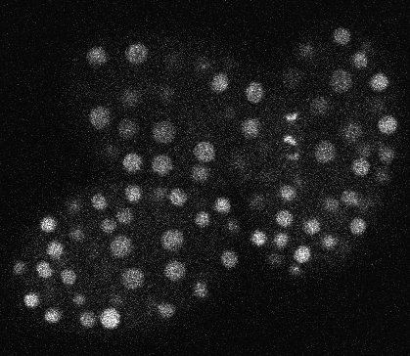
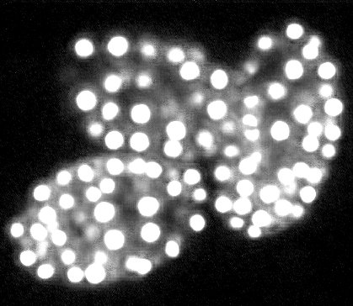
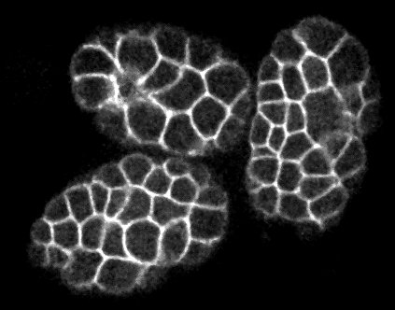
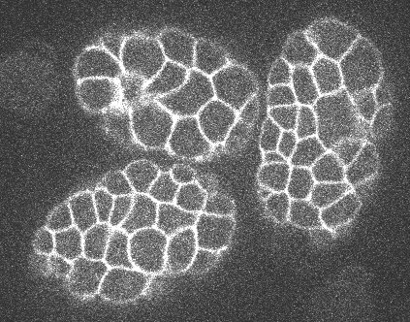
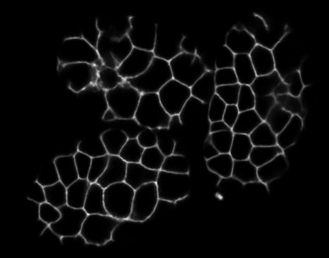
CSBDeep on celegans images
Results on celegans images.
Nucleus:
CSBDeep trained on Planaria dataset
Membrane:
CSBDeep trained on Flywing dataset
(comparison) Median 3D filter + adjust brightness
CSB
CSB
normal

Slide 4
Some note
CSBDeep image looks very clear with very few noises remaining.
However, It do takes much longer processing time, about 20x more running time than our normal denoising procedure. However, I used it with tensorflow CPU version on a commodity PC. They do have a GPU version which works only on Linux servers and need some setups.
CSBDeep currently takes a stack of 30 slices and only output the denoised image of one slice. I see no option to choose which slice. Maybe it is caused by dataset difference. I assume in their dataset, all slices in a stack looks very similar?

Slide 5
Reference
CSBDeep paper: Weigert, Martin, et al. "Content-Aware Image Restoration: Pushing the Limits of Fluorescence Microscopy." bioRxiv(2017): 236463.
CSBDeep website: http://csbdeep.bioimagecomputing.com/

